Slide 1
Training Models

Slide 2
Setting up your Machine Learning Application
Train / Dev / Test sets
While training a deep neural network, we are required to make a lot of decisions regarding the following hyperparameters:
Number of hidden layers in the network
Number of hidden units for each hidden layer
Learning rate
Activation function for different layers, etc

Slide 3
Choosing hyperparameters
Number of hidden layers in the network
Number of hidden units for each hidden layer
Learning rate
Activation function for different layers, etc.

Slide 4
Choosing the hyperparameters
Start with an idea, i.e. start with a certain number of hidden layers, certain learning rate, etc.
Try the idea by coding it
Experiment how well the idea has worked
Refine the idea and iterate this process

Slide 5
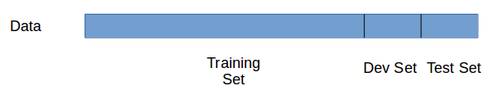
Dividing the dataset
We can divide this dataset into three different sets like:

Slide 6
Dividing the dataset
Training Set: We train the model on the training data.
Dev Set: After training the model, we check how well it performs on the dev set.
Test Set: When we have a final model (i.e., the model that has performed well on both training as well as dev set), we evaluate it on the test set in order to get an unbiased estimate of how well our algorithm is doing.

Slide 7
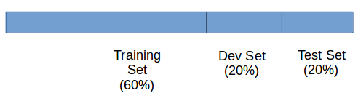
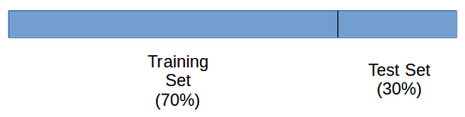
Training,Dev,Test

Slide 8
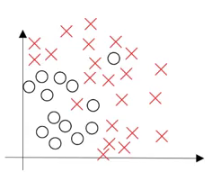
Bias / Variance
Consider a dataset which gives us the below plot:

Slide 9
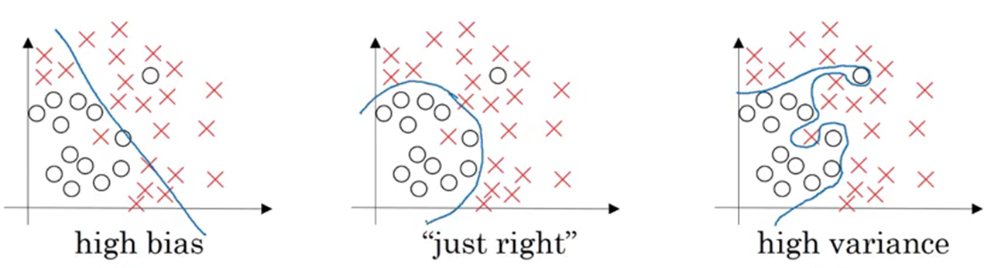
Bias / Variance

Slide 10
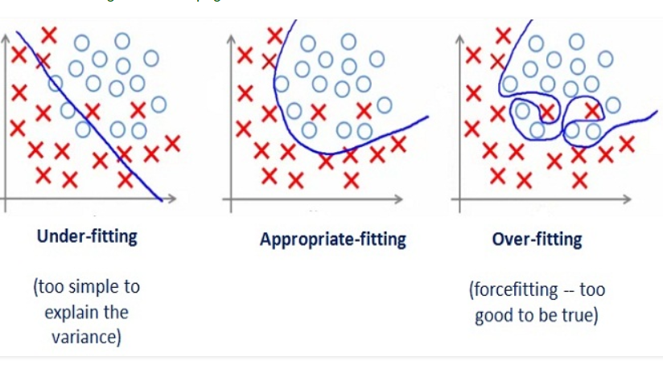
Underfitting,Appropriate-fitting Overfitting

Slide 11
Bias / Variance
If we fit a straight line to classify the points into different classes the model will under-fit and have a high bias.
On the other hand, if we fit the data perfectly, i.e., all the points are classified into their respective class, we will have high variance (and overfitting).
The right model fit is usually found between these two extremes:

Slide 12
Bias / Variance
We want our model to be just right, which means having low bias and low variance.
We can decide if the model should have high bias or high variance by checking the train set and dev set error.

Slide 13
Model Development Tricks
If the dev set error is much more than the train set error, the model is overfitting and has a high variance
When both train and dev set errors are high, the model is underfitting and has a high bias
If the train set error is high and the dev set error is even worse, the model has both high bias and high variance
And when both the train and dev set errors are small, the model fits the data reasonably and has low bias and low variance

